Slide 1
Team name:
Gopher bots
Team members :-
P .VAMSHI KRISHNA 187Y5A0451
SHIRISHA 187Y1A04a8
SAI VARDHAN 187Y1A04f9

Slide 2
Smart security system for homes

Slide 3
ABSTRACT
Now a days the technology is increasing rapidly, this leads to an upgradation in home security system . automation in security sector makes it more authentic. There are many electrical equipment’s are available in home which are in necessity of monitoring from a remote area all at a time. In paper a home security system is proposed along with the face detection technique. A stand alone system through internet of things as a network of communication is implemented. Raspberry pi is use as controlling unit codded in python language.
Home security systems are a need of the modern day houses. It is possible to design a simple home security solution by using raspberry pi and utilizing the power of internet of things. The home security system designed in this project is a simple and easily installable device built using raspberry pi 3, web cam and servo motor.
The device designed in this project can be installed at the main entrance of a house. It detects motion of any visitor and starts capturing the images with the help of a USB web cam. The images are temporarily stored on the raspberry pi.. . The pi uses open cv library to capture images from the web cam and saves the images in a specified folder.

Slide 4
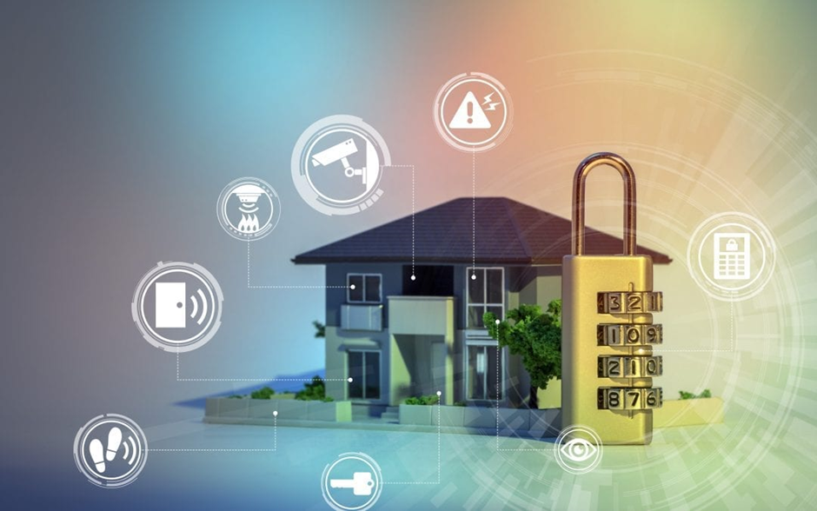
INTRODUCTION
The present scenario ensures the safety and security has become an inevitably essential. There is a regressive progress in the security system as the influence of modern technology is reaching its peak. When there is a modern home with minimum human effort, it’s well known as modern home. Since there is an advent of wireless and digital technologies, all together it introduces a automated intelligent security system. The automated home security system can be designed with the surveillance camera .
The objective of this paper is home security using raspberry pi . images of authorized person is stored in the data base and when some human encounter the camera, camera will capture the image and compare that with the data base. When the image matches with the data base the name pop us will come of that particular authorized human and opens the door.

Slide 5
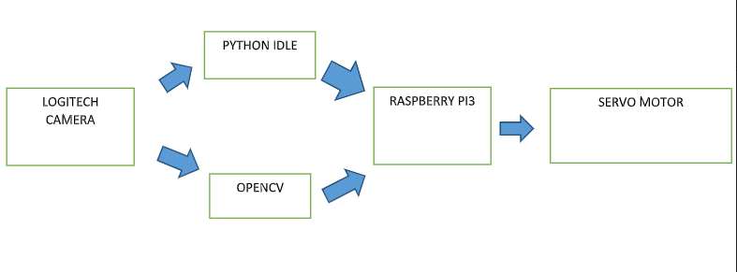
Block Diagram :-

Slide 6
Hardware
The hardware that I used in this project:
* Raspberry pi3
* Logitech camera
* Servo motor
* Connecting wires

Slide 7
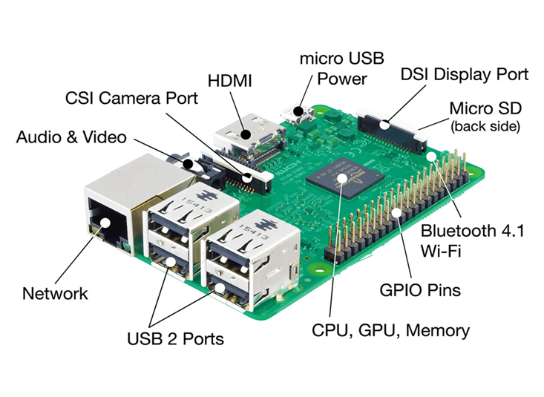
Raspberry pi3:
Raspberry pi 3 is the third generation raspberry pi. It is a miniature marvel, packing considerable computing power into a footprint no larger than a credit card. The processor at the heart of the raspberry pi system is a broadcom BCM2837 system-on-chip (soc) which houses a 1.2 GHz quad core ARM cortex-a53 processor. The vast majority of the system’s components, including its central and graphics processing units along with the audio and communications hardware, are built onto that single component along with 1 GB LPDDR2 memory chip at the centre of the board. It is not just this soc design that makes the BCM2837 different to the processor found in a typical desktop or laptop, however, it also uses a different instruction set architecture (ISA), known as ARM.

Slide 8
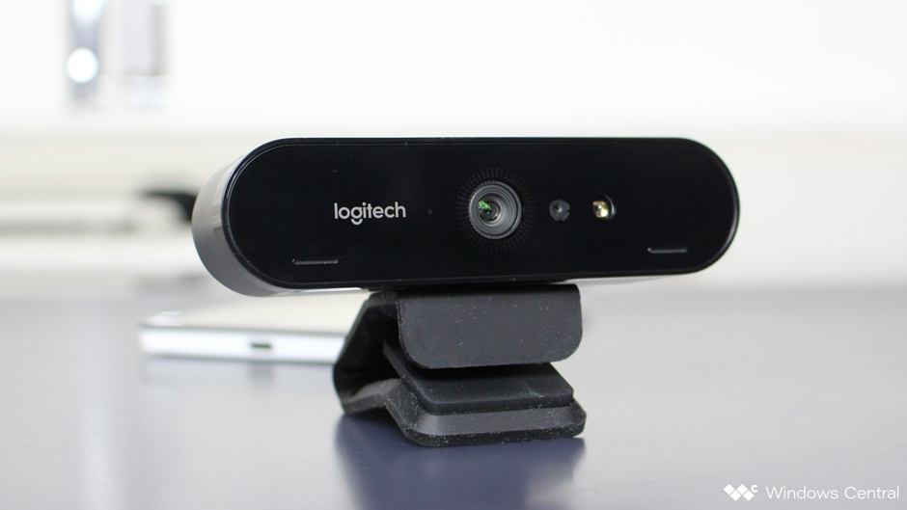
Logitech Camera:
Logitech has released its new Logitech BRIO 4K pro webcam with support for windows hello and other secure infrared-based facial recognition applications.
The webcam is equipped with a second infrared LED and sensor, enabling users to combine it with the primary sensor and configured software to make the device windows hello certified so it can be used with the microsoft security feature to login via facial recognition.

Slide 9
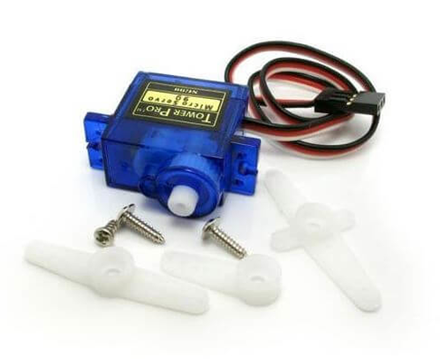
Servo Motor:
There are lots of servo motors available in the market and each one has its own speciality and applications. The following two paragraphs will help you identify the right type of servo motor for your project/system.
Most of the hobby servo motors operates from 4.8V to 6.5V, the higher the voltage higher the torque we can achieve, but most commonly they are operated at +5V. Almost all hobby servo motors can rotate only from 0° to 180° due to their gear arrangement so make sure you project can live with the half circle if no, you can prefer for a 0° to 360° motor or modify the motor to make a full circle. The gears in the motors are easily subjected to wear and tear, so if your application requires stronger and long running motors you can go with metal gears or just stick with normal plastic gear.

Slide 10
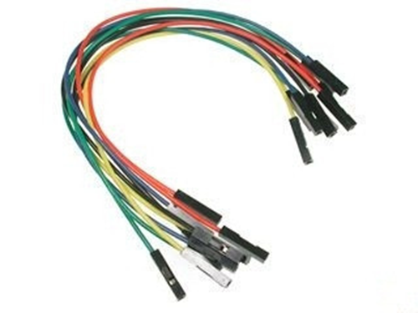
Connecting wires:
A jump wire (also known as jumper wire, or jumper) is an electrical wire, or group of them in a cable, with a connector or pin at each end (or sometimes without them – simply "tinned"), which is normally used to interconnect the components of a breadboard or other prototype or test circuit, internally or with other equipment or components, without soldering.
Individual jump wires are fitted by inserting their "end connectors" into the slots provided in a breadboard, the header connector of a circuit board, or a piece of test equipment.

Slide 11
Software:
* Python IDLE.
* OpenCV.

Slide 12
Python IDLE:
IDLE is python’s integrated development and learning environment.
The features of IDLE are :it is coded in 100% pure python, using the tkinter GUI toolkit cross-platform: works mostly the same on windows, unix, and macos python shell window (interactive interpreter) with colorizing of code input, output, and error messages multi-window text editor with multiple undo, python colorizing, smart indent, call tips, auto completion, and other features search within any window, replace within editor windows, and search through multiple files (grep) debugger with persistent breakpoints, stepping, and viewing of global and local namespaces configuration, browsers, and other dialogs.
Python Shell window:
With idle’s shell, one enters, edits, and recalls complete statements. Most consoles and terminals only work with a single physical line at a time.
When one pastes code into shell, it is not compiled and possibly executed until one hits return. One may edit pasted code first. If one pastes more that one statement into shell, the result will be a syntax error when multiple statements are compiled as if they were one.

Slide 13
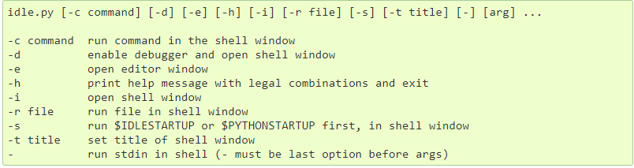
Command line usage:

Slide 14
OpenCV:
Opencv (open source computer vision) is a library of programming functions mainly aimed at real-time computer vision. Originally developed by intel, it was later supported by willow garage then it seez (which was later acquired by intel). The library is cross-platform and free for use under the open-source BSD license.
Opencv supports the deep learning frameworks tensorflow, torch/pytorch and caffe.
Programming language for OpenCV:
Opencv is written in C++ and its primary interface is in C++, but it still retains a less comprehensive though extensive older C interface. There are bindings in python, java and MATLAB/OCTAVE. The API for these interfaces can be found in the online documentation. Wrappers in other languages such as C#, perl, ch, haskell, and ruby have been developed to encourage adoption by a wider audience.
Since version 3.4, opencv.Js is a javascript binding for selected subset of opencv functions for the web platform.
All of the new developments and algorithms in opencv are now developed in the c++ interface.

Slide 15
OS Support:
Opencv runs on the following desktop operating systems: windows, linux, macos, freebsd, netbsd, openbsd. Opencv runs on the following mobile operating systems: android, ios, maemo, blackberry 10. The user can get official releases from source forge or take the latest sources from github. Opencv uses cmake.
Back ground on face recogniotion:
Face detection: look at the picture and find a face in it.
Data gathering: extract unique characteristics of face that it can use to differentiate him from another person, like eyes, mouth, nose, etc.
Data comparison: despite variations in light or expression, it will compare those unique features to all the features of all the people you know.
Face recognition: it will determine the person in the photo.

Slide 16
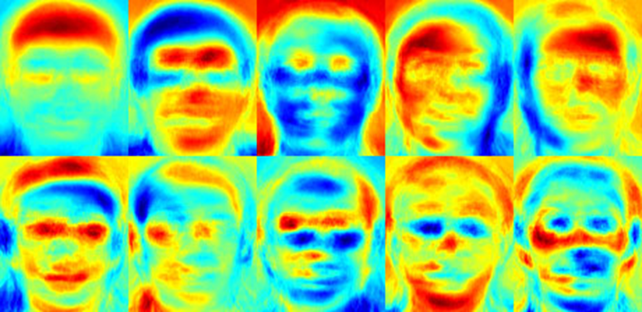
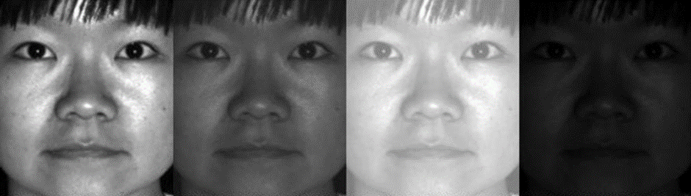
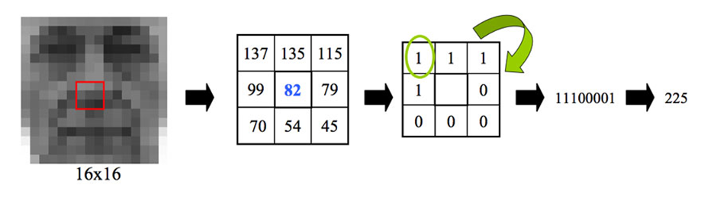

Slide 17
ADVANTAGES OF SMART SECURITY SYSTEM :
1.Adding convenience to your daily life .
2.Customization .
3.Security – smart home security systems allow you to view your home no matter where you are. You can have cameras installed, motion detectors, locks, etc and you will be notified immediately if something is out of the ordinary. Many of these systems will even let you know of any unexpected temperature changes so that you’re alerted if there is a possible fire.
4.Ease of use .
5.Save money and the environment.

Slide 18
CONCLUSION:
Overall, this study has been completed properly. All sub-objective of this study has been completed, thus resolved the main objectives and research problems. This system managed to help users to detect human presence around the house precisely. The use of wireless connectivity based on microcontroller facilitates the installation process at home and can prevent anyone hacking into security systems. This system is a system that meets recently smart home applications in order to function in automation situation. During the study, a lot of knowledge and experience have been learned. Besides the exposure on microcontroller, this study also has much exposure to radio frequency technology which is xbee pro, where it helps in the transfer process for the wireless signal. This device has helped the development of security systems with its high-tech features.

Slide 19
Thank you

